Slide 1
Final Presentation
The Movie-Chain-Runner Project
Sung Uk Ryu & Jimmy Zong
In collaboration with
Eugene Scanlon & Shashank Singh
June 27, 2013

Slide 2
Overview
Goal
Technology
Approach
Results
Summary
Overview Goal Technology Approach Results Summary

Slide 3
Goal
The Problem
  Find the “longest” list of overlapping titles in a list of movie titles.
Example: In the list
  Day of the Dead
  Live and Let Die
  Dead Poets’ Society
  Die Another Day
  The Last Samurai
The “longest” chain is
  “Live and Let Die Another Day of the Dead Poets’ Society.”
Overview Goal Technology Approach Results Summary

Slide 4
Technology
The Problem
  Find the “longest” list of overlapping titles in a list of movie titles.
Example: In the list
  Day of the Dead
  Live and Let Die
  Dead Poets’ Society
  Die Another Day
  The Last Samurai
The “longest” chain is
  “Live and Let Die Another Day of the Dead Poets’ Society.”
Overview Goal Technology Approach Results Summary

Slide 5
Approach
The Problem
  Find the “longest” list of overlapping titles in a list of movie titles.
Example: In the list
  Day of the Dead
  Live and Let Die
  Dead Poets’ Society
  Die Another Day
  The Last Samurai
The “longest” chain is
  “Live and Let Die Another Day of the Dead Poets’ Society.”
Overview Goal Technology Approach Results Summary

Slide 6
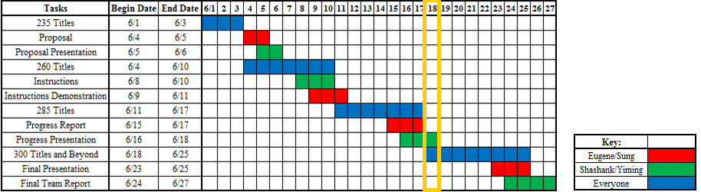
Approach
Planned Schedule
< Initial Gantt Chart >
Overview Goal Technology Approach Results Summary

Slide 7
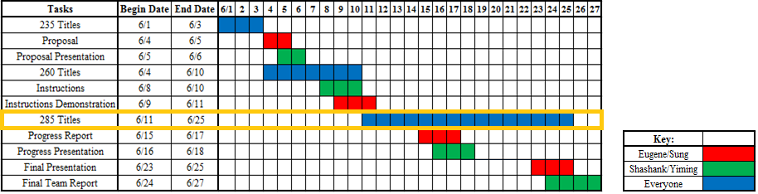
Approach
Revised Schedule
< Revised Gantt Chart >
Overview Goal Technology Approach Results Summary

Slide 8
Results
The Problem
  Find the “longest” list of overlapping titles in a list of movie titles.
Example: In the list
  Day of the Dead
  Live and Let Die
  Dead Poets’ Society
  Die Another Day
  The Last Samurai
The “longest” chain is
  “Live and Let Die Another Day of the Dead Poets’ Society.”
Overview Goal Technology Approach Results Summary

Slide 9
Summary
The Problem
  Find the “longest” list of overlapping titles in a list of movie titles.
Example: In the list
  Day of the Dead
  Live and Let Die
  Dead Poets’ Society
  Die Another Day
  The Last Samurai
The “longest” chain is
  “Live and Let Die Another Day of the Dead Poets’ Society.”
Overview Goal Technology Approach Results Summary

Slide 10
General Progress
Review of Initial Plan
  Attempt to make the longest chain of consecutive movie titles
< Initial Gantt Chart >
Overview Goal Technology Approach Results Summary

Slide 11
Current Status
Currently at 278 titles
Still working on breaking 285 titles
  Currently working on an algorithm that attempts to squeeze a longer chain in between any 2 titles that are already in our chain.
  Another idea is to find and remove nodes that are unlikely to be in the longest chain.
Overview Goal Technology Approach Results Summary

Slide 12
Projections
Fallen slightly behind on the 285 title deadline.
Our goal should change to be 285 titles
  It gets exponentially difficult to increase our chain length and when it increases, it is only by 1 or 2 words.
Recommendation on Final deliverable
  Change our target to be 285 titles instead of breaking the record
Overview Goal Technology Approach Results Summary

Slide 13
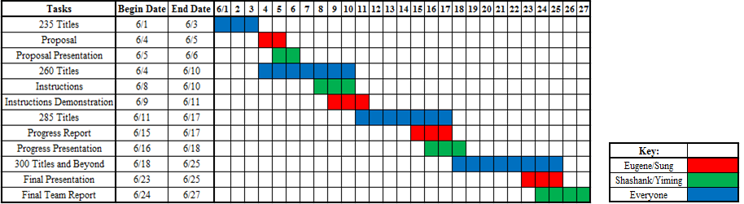
Projections
< Initial Gantt Chart >
Overview Goal Technology Approach Results Summary

Slide 14
Projections
< Revised Gantt Chart >
Overview Goal Technology Approach Results Summary

Slide 15
Summary
Recap
  General Progress
  Current Status
  Projections
Discussion
  Changing our final target to be 285 titles
  Current task is to achieve 285 titles
  If met, use remaining time to achieve 300 titles or higher
Overview Goal Technology Approach Results Summary

